Slide 1
Ethernet LANs
Maximizing the Benefits of Switching

Slide 2
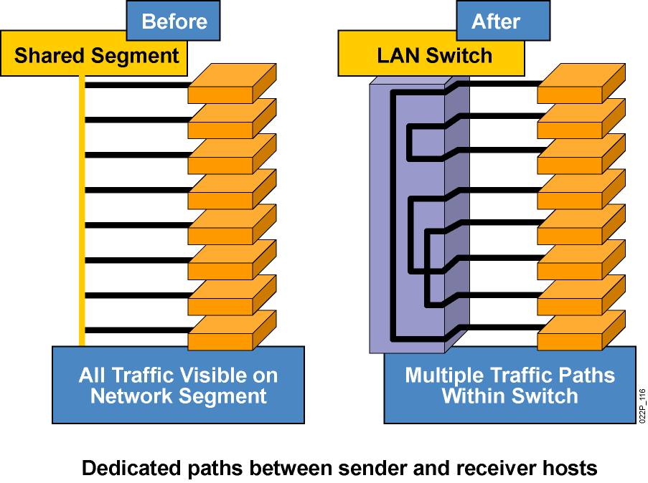
Microsegmentation
Microsegmentation of the Network
Notes:
Lesson Aim
<Enter lesson aim here.>

Slide 3
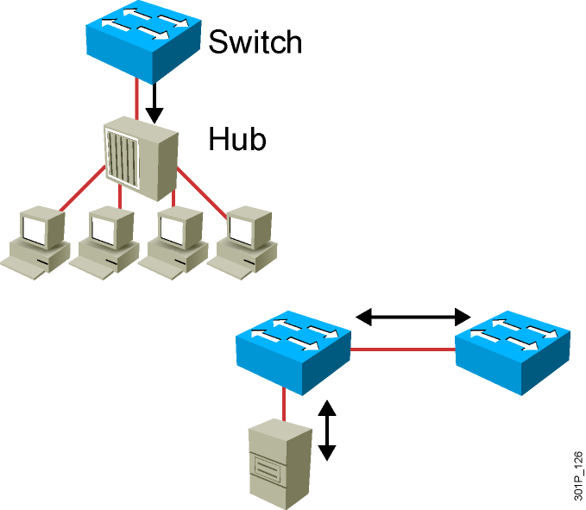
Duplex Overview
Half Duplex (CSMA/CD)
  Unidirectional data flow
  Higher potential for collision
  Hub connectivity
Full Duplex
  Point-to-point only
  Attached to dedicated switched port
  Requires full-duplex support on both ends
  Collision-free
  Collision detect circuit disabled
Notes:
Slide 2 of 2
Emphasize: Full duplex is for point-to-point connections only. A Fast Ethernet full-duplex connection provides a throughput of 200 Mbps (100 Mbps per direction).
Note:

Slide 4
Setting Duplex and Speed Options
Cisco Catalyst 2960 Series
SwitchX(config)#interface fa0/1
SwitchX(config-if)#duplex {auto | full | half}
Cisco Catalyst 2960 Series
SwitchX(config)#interface fa0/1
SwitchX(config-if)#speed {10 | 100 | 1000 | auto}
Notes:
Emphasize: “Half” is the default on the Ethernet ports.

Slide 5
Showing Duplex Options
SwitchX#show interfaces fastethernet0/2
FastEthernet0/2 is up, line protocol is up (connected)
Hardware is Fast Ethernet, address is 0008.a445.9b42 (bia 0008.a445.9b42)
MTU 1500 bytes, BW 10000 Kbit, DLY 1000 usec,
reliability 255/255, txload 1/255, rxload 1/255
Encapsulation ARPA, loopback not set
Keepalive set (10 sec)
Half-duplex, 10Mb/s
input flow-control is unsupported output flow-control is unsupported
ARP type: ARPA, ARP Timeout 04:00:00
Last input 00:00:57, output 00:00:01, output hang never
Last clearing of "show interface" counters never
Input queue: 0/75/0/0 (size/max/drops/flushes); Total output drops: 0
Queueing strategy: fifo
Output queue: 0/40 (size/max)
5 minute input rate 0 bits/sec, 0 packets/sec
5 minute output rate 0 bits/sec, 0 packets/sec
323479 packets input, 44931071 bytes, 0 no buffer
Received 98960 broadcasts (0 multicast)
1 runts, 0 giants, 0 throttles
1 input errors, 0 CRC, 0 frame, 0 overrun, 0 ignored
0 watchdog, 36374 multicast, 0 pause input
0 input packets with dribble condition detected
1284934 packets output, 103121707 bytes, 0 underruns
0 output errors, 2 collisions, 6 interface resets
0 babbles, 0 late collision, 29 deferred
0 lost carrier, 0 no carrier, 0 PAUSE output
0 output buffer failures, 0 output buffers swapped out
Notes:
Emphasize: The show interfaces command will display the duplex status.
FCS errors and late collision errors are discussed in a later slide.

Slide 6
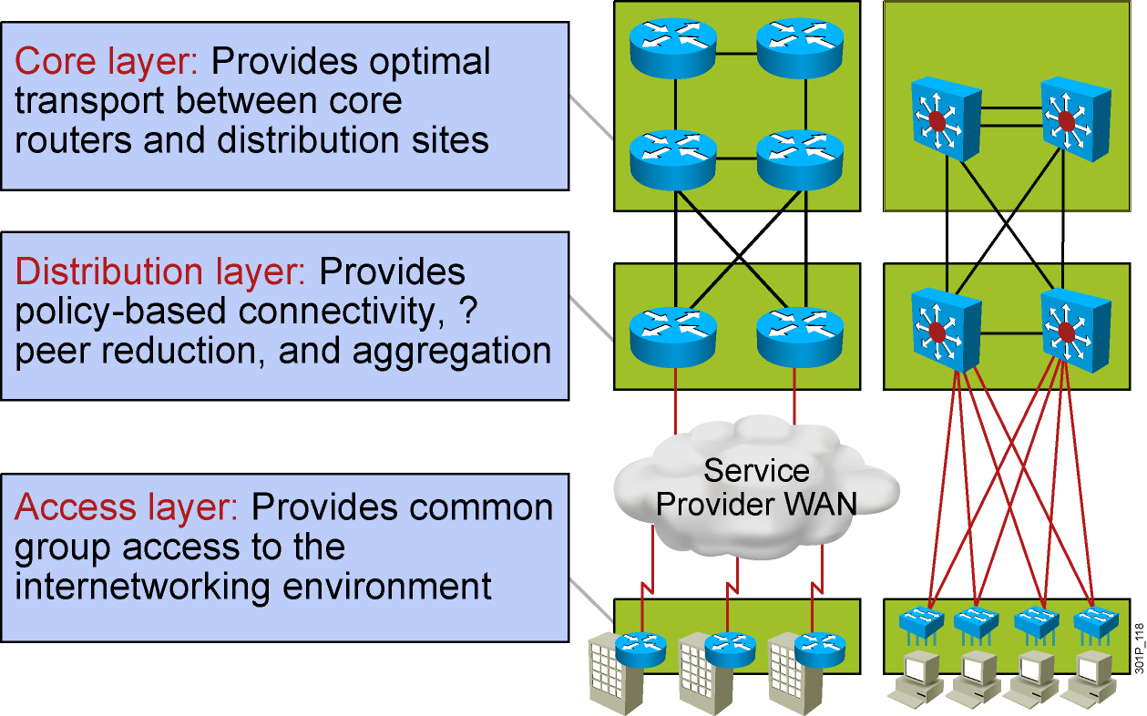
The Hierarchy of Connectivity

Slide 7
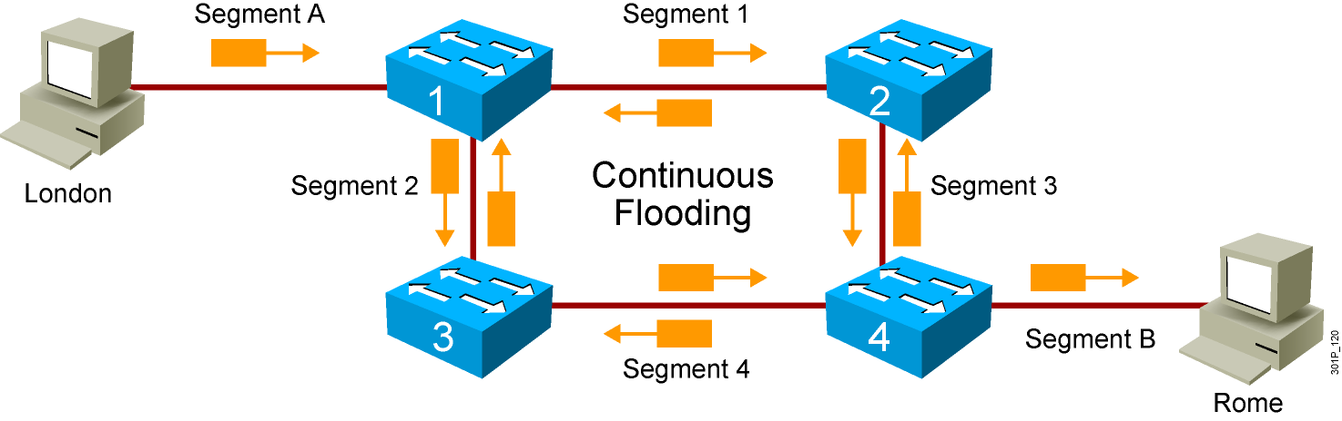
Loops
Notes:
Lesson Aim
<Enter lesson aim here.>

Slide 8
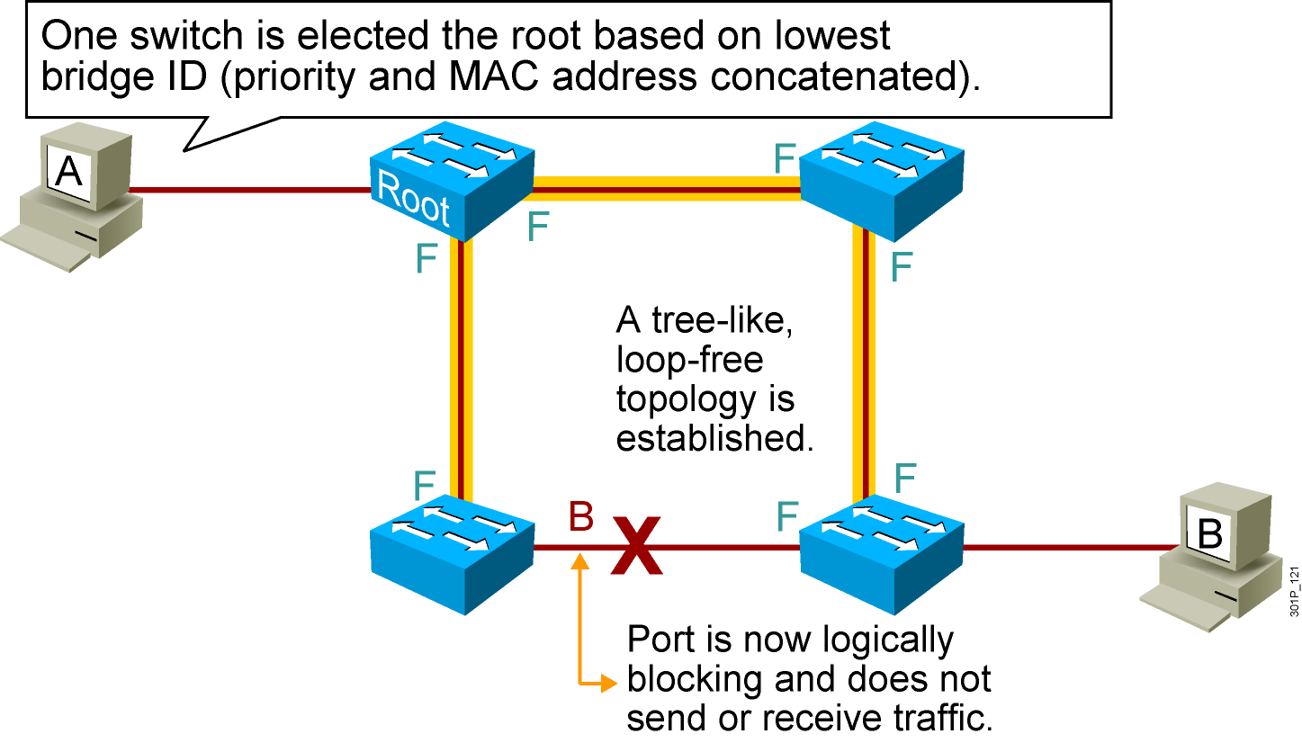
Spanning Tree Protocol

Slide 9
Summary
  Switched LANs provide microsegmentation, which means that each device on a network segment is connected directly to a switch port and receives its own bandwidth; each device does not have to contend for bandwidth with any other device on the network.
  Half-duplex communication in an Ethernet LAN allows data transmission in only one direction at a time (either sending or receiving); full-duplex communication allows both sending and receiving of data simultaneously. Switches provide full-duplex communication capability.
  Employing a hierarchy of Ethernet connectivity is usually the most efficient way to provide speed where it will be most effective in a campus network, implementing Fast Ethernet and Gigabit Ethernet primarily in workgroup and backbone connections.

Slide 10
Summary (Cont.)
  Loops result when switches connected to the same segment transmit the same data. The data frames circulate between the two paths without being removed from the network and may cause inaccurate data in the MAC address tables.
  The solution to loops is STP, which manages the paths to given network segments. STP provides path redundancy in an Ethernet LAN while preventing undesirable active loops in the network.

